Slide 1

2023
HPS
Team8
Notes:
Welcome
歡迎畫面
再按一下：游標閃爍動畫

Slide 2
Notes:
（不用按，過場用）

Slide 3
Gootdle
Gootdle
Gootdle
Gootdle
#
Notes:
游標閃爍動畫
再按一下：#ootd 出現的打字動畫
游標繼續閃爍
再按一下：Introducing Gootdle 動畫

Slide 4
Gootdle
Gootdle
Gootdle
Gootdle
#
Notes:
（不用按，過場用）

Slide 5
Gootdle
Notes:
（不用按，過場用）

Slide 6
Gootdle
Gootdle
Notes:
（不用按，過場用）

Slide 7
Gootdle
Smart dressing, zero messing.
Notes:
Introducing Gootdle
第一次 Demo
再按一下：Gootdle 消失動畫，轉場成 Design

Slide 8

Gootdle
Smart dressing, zero messing.
Notes:
（不用按，過場用）

Slide 9
Notes:
（不用按，過場用）

Slide 10
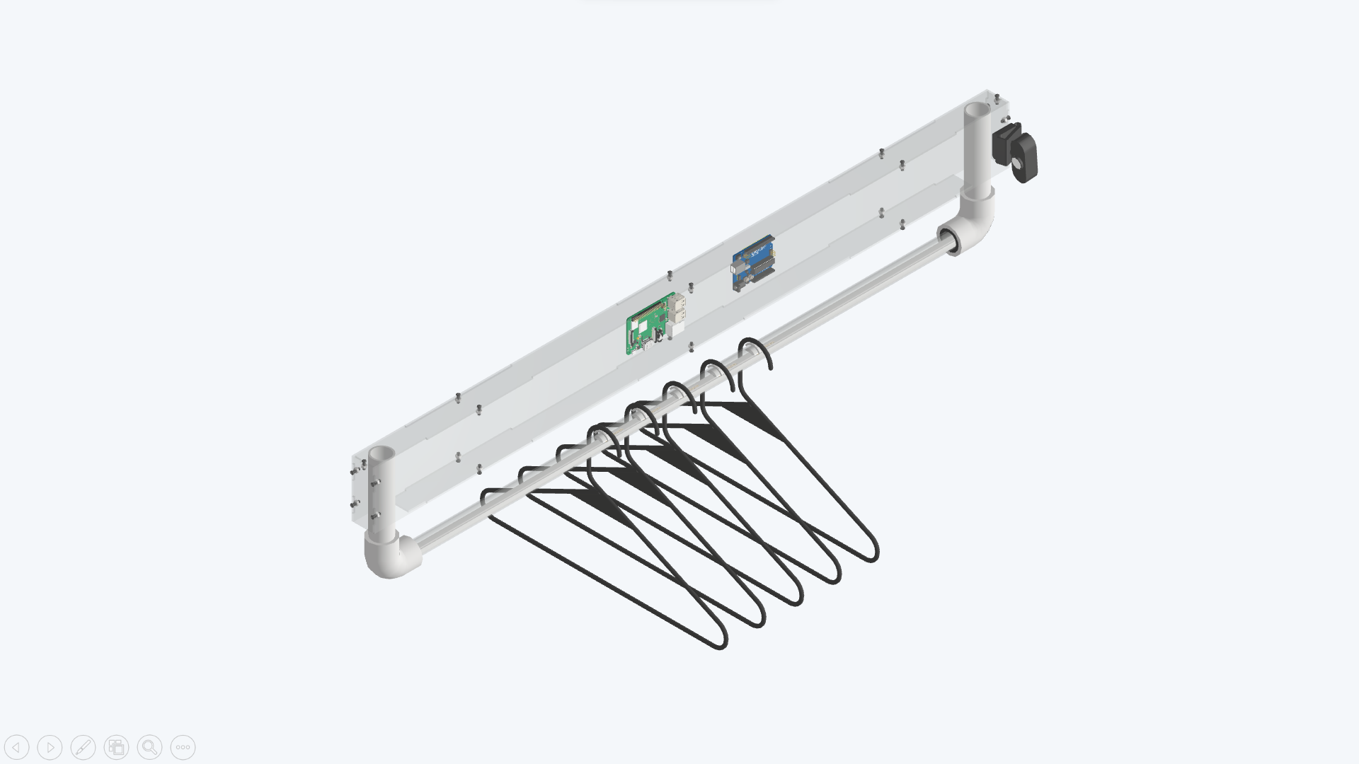


Slide 11
Camera
Used computer vision to identify what cloth you are holding.
Arduino
Raspberry Pi
Controlled LEDs and sensors and sent signals to Raspberry Pi.
Communicated with backend server.
Force Sensing Elements
Located the clothes hung on clothing rail.

Slide 13
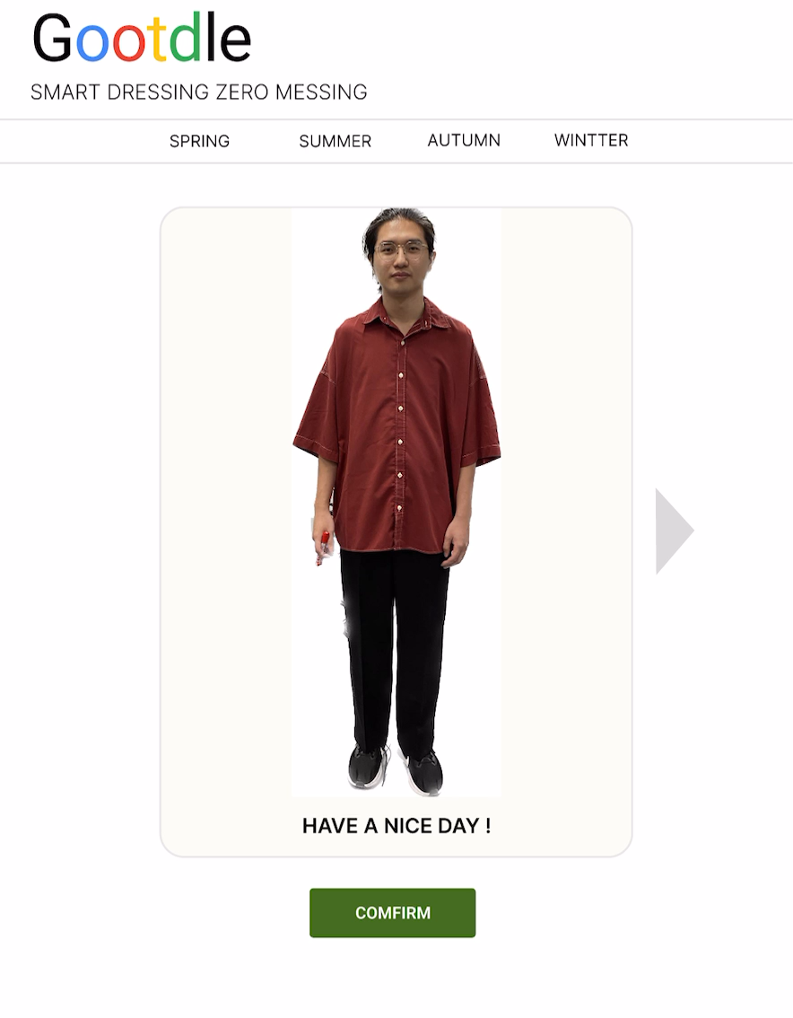
Clothes Recommandation
Find the perfect style for
you.

Slide 14
Clothes Recommandation
Find the perfect style for
you.

Slide 15
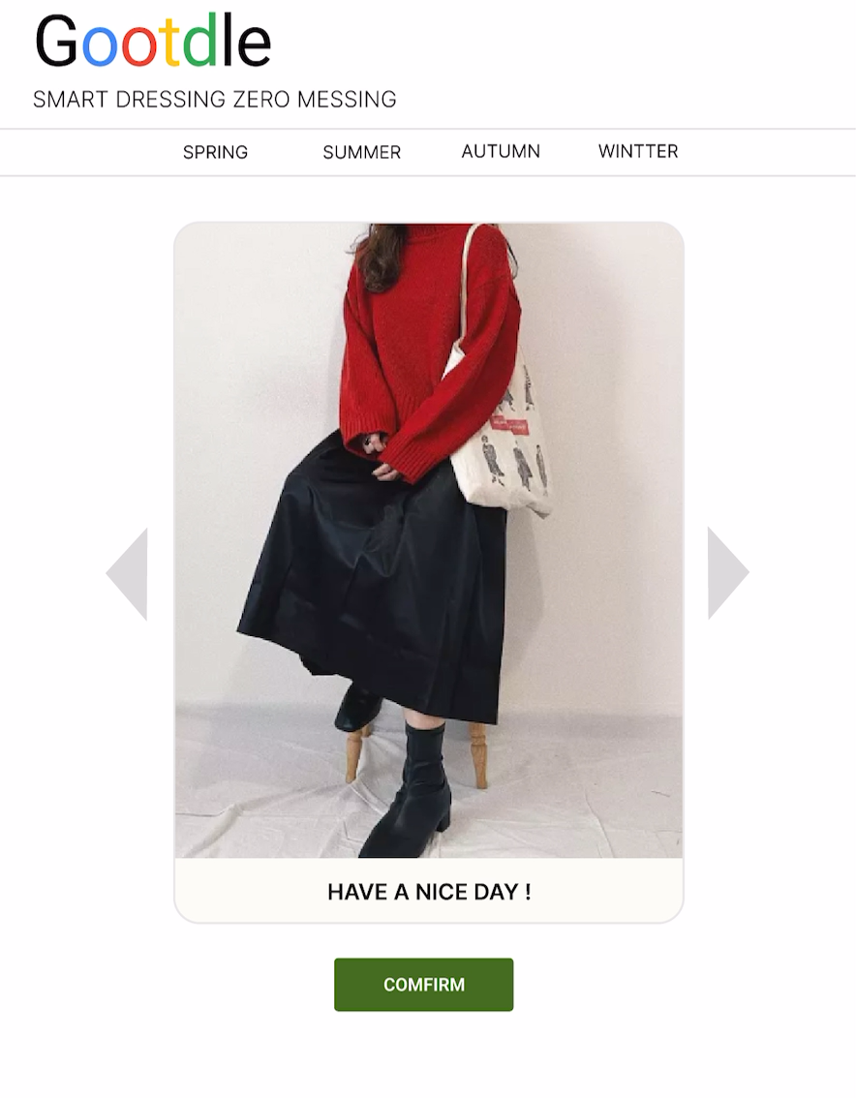
Clothes Recommandation
Find the perfect style for
you.

Slide 18
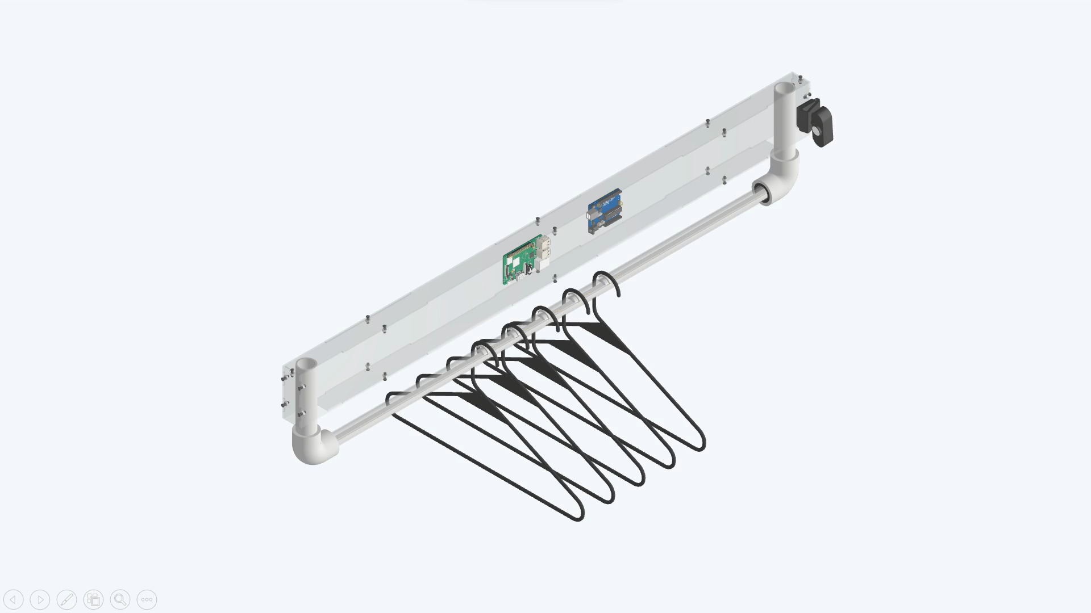

Slide 19
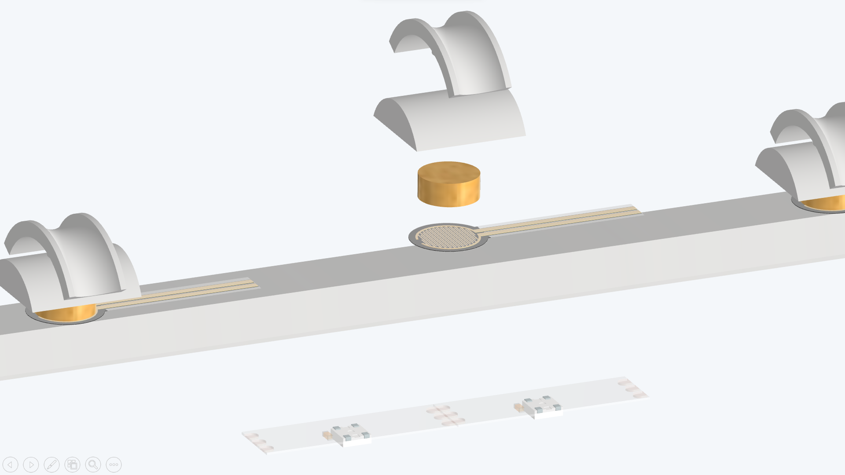

Slide 20
Slot
Hard Cushion
Soft Cushion
Force Sensor
WS2812 LED

Slide 21

Persona
Name：Elena
Location：Taipei
Age：25
MBTI：INTP
Occupation：Silicon Engineer
Hobby：Photography
Salary：90k
Hope：Improve self-confidence

Slide 22


Personal
Commercial
Age：25 – 40
Salary：45k up
Occupation：white - collar worker、KOL
Demand： outfit recommendations 、
a lot of clothes lacking proper organization
Scale：SME、large enterprise
Industry：service industry
Types：clothing boutiques、bridal shops
Demand： provide virtual try - on service、commodity and clothing organization

Slide 23


市場規模
TAIWAN
KOREA
6.82 million people
30 million people
Middle to upper-class working professionals with fashion needs
TAM
3.61 million people
22 million people
Clothing Boutiques, Bridal Shops, and Working Professionals Looking to Enhance Their Dressing Experience
SAM
490,000 people
10 million people
According to the market research results
the proportion of people interested in the product
Based on market research results in Taiwan
SOM
Notes:
1.Demo
Design
Cad
2.先臺灣後日本，拐杖銷售額
上班族 平日上班

Slide 24
市場規模
TAIWAN
6.82 million people
Middle to upper-class working professionals with fashion needs
TAM
3.61 million people
Clothing Boutiques, Bridal Shops, and Working Professionals Looking to Enhance Their Dressing Experience
SAM
490,000 people
SOM
According to the market research results the proportion of people interested in the product
Notes:
1.Demo
Design
Cad
2.先臺灣後日本，拐杖銷售額
上班族 平日上班

Slide 25
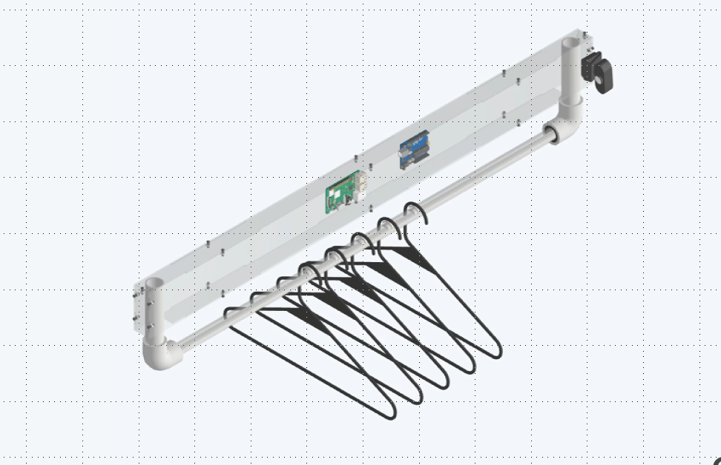

產品定價
Operating Costs
12100
Others
3000
Webcam
Acrylic Shell
Raspberry Pi
Pressure Sensor
(Number of Hangers)
PVC Pipe
Spray Paint
Wiring
4000
2000
2000
300*5
300
200
100
Other Materials
Research and Development Costs
1000
2000
Price
NT 32,700 ～ NT 38,150
Notes:
壓2000
線材 100
壓力感測器 300
樹梅派 2000
Webcame 4000
噴漆 200
pvc水管 300
衣架

Slide 26
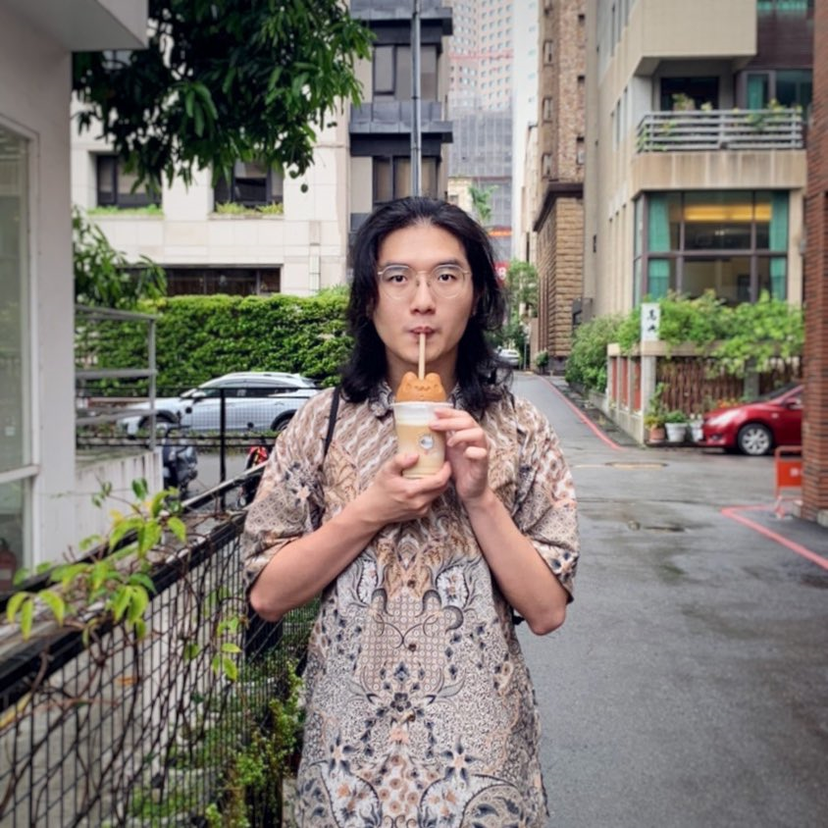

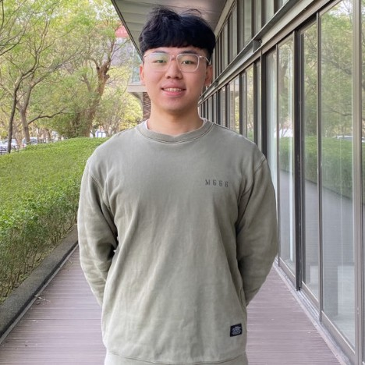
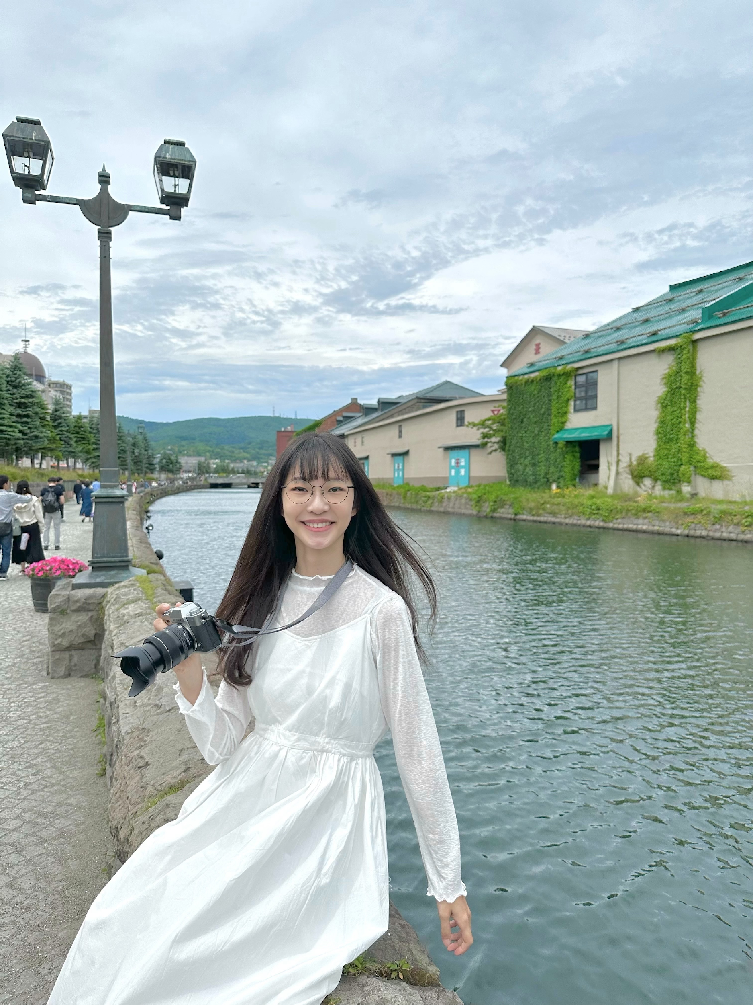

DB Events
Database
Web Server
Andrew
Web Cam
Raspberry Pi
Backend
Frontend
Arduino
Serial
Mac
Computer
Vision
Penny
Mechanism
Force Sensor
LED
Laser Cutting
3D Printing
Max
Yushan
Marshall

